Slide 1


Faculty of Computing and Informatics
Week 3
Database System Concepts & Architecture

Slide 2
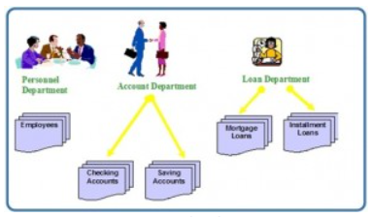
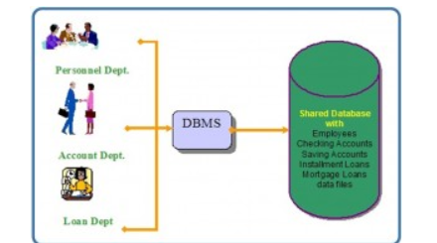
Recap

Slide 3
Recap
In the previous lesson we discussed:
History of database approach
Characteristics of database approach
Database Management System

Slide 4
Objectives
At the end of this lesson, students should be able to
Client server architecture
Types of database systems
Database system concepts

Slide 5
DBMS architecture
Database applications are usually partitioned into two or three parts.
They are:
  Two – Tier Architecture.
  Three – Tier Architecture.

Slide 6
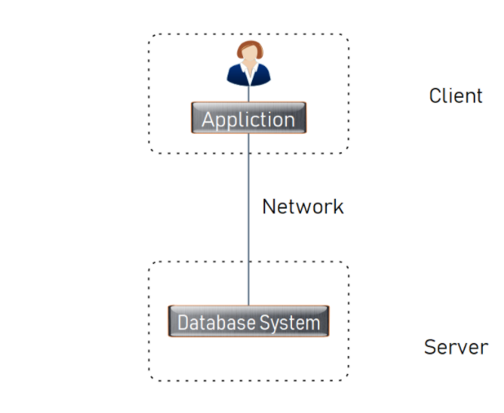
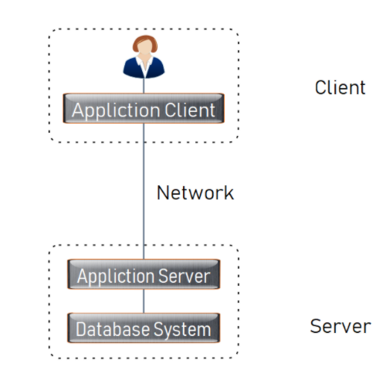
DBMS architecture
Two-tier architecture
Three-tier architecture

Slide 7
Two-tier
The application is partitioned into a component that resides at the client machine, which invokes database system functionality at the server machine through query language statements.
The architectures described here are called two-tier architectures because the software components are distributed over two systems: client and server.

Slide 8
Two-tier
The advantages of this architecture are its simplicity and seamless compatibility with existing systems.
Homework
What other advantages can you identify for this architecture?

Slide 9
Three-tier
adds an intermediate layer between the client and the database server,
The client machine acts as merely a front end and does not contain any direct database calls.
The client end communicates with an application server.
The application server in turn communicates with a database system to access data.
Three-tier applications are more appropriate for large applications, and for applications that run on the World Wide Web.

Slide 10
Three tier
Homework
List and describe the advantages and disadvantages of the three-tier database architecture.

Slide 11
Data Models
A database model is a collection of tools for describing data, data relationships, data semantic and consistency constraints.
the data model is the underlying the structure of a database
Hides details of data storage
Notes:
A set of concepts that can be used to describe the structure of a database: the data types, relationships, constraints, semantics and operational behaviour

Slide 12
Data Models
They can be broadly classified into the following categories:
    1. Conceptual database models.
    2. Physical database models.
    3. Logical database models.

Slide 13
1. Conceptual model
Provide concepts that are close to the way people perceive data to present the data.
E.g. Entity – relationship model which use main concepts like entities, attributes, relationships.
An entity represents real-world object such as an employee, a project.
An entity has some attributes which represents properties of entity such as employee’s name, address, birthdate.
A relationship represents association among entities for example a works on relationships between employee and project.
The overall logical structure of a database can be expressed graphically by an E-R diagram.
We will look at this concept in more detail in week 5
Notes:
E-R model
The entity-relationship (E-R) data model is based on a perception of a real world that consists of a collection of basic objects, called entities, and of relationships among these objects.
An entity is a “thing” or “object” in the real world that is distinguishable from other objects. For example, each person is an entity, and bank accounts can be considered as entities.
A relationship is an association among several entities. For example, a depositor relationship associates a customer with each account that she has.
The set of all entities of the same type and the set of all relationships of the same type are termed an entity set and relationship set, respectively.
The overall logical structure (schema) of a database can be expressed graphically by an E-R diagram.

Slide 14
2. Logical model
This level describes what data are stored in the whole database
Provide concepts that can be understood by the user but not too far from the way data is stored in the computer.
Three well-known data models of this type are
relational data model,
network data model and
hierarchical data model.
We will revisit these later in the lesson

Slide 15
3. Physical model
The lowest level of abstraction describes how the data are actually stored.
Provide concepts that describe how data is actually stored in the computer.
Use of SQL statements

Slide 16
Database schema
The description of the database which is designed in the early stage and is not expected to change frequently is called the database schema
The description of a database is called the database schema, which is specified during database design and is not expected to change frequently.
The overall design of the database is called the database schema.
Schema changes are usually needed as the requirements of the database applications change.
Defined at different levels to separate user applications from the physical database

Slide 17
Database schema
1. Internal schema, which describes the physical storage structure of the database.
The internal schema uses a physical data model and describes the complete details of data storage and access paths for the database.
2. Conceptual schema, which describes the structure of the whole database for a community of users.
The conceptual schema hides the details of physical storage structures and concentrates on describing entities, data types, relationships, user operations, and constraints.

Slide 18
Database schema
3. The external or view level includes a number of external schemas or user views.
Each external schema describes the part of the database that a particular user group is interested in and hides the rest of the database from that user group.

Slide 19
Database Schema
The schema of a database is held in the data dictionary or repository.
A data dictionary contains metadata i.e data about the database.
Data dictionary is an inventory of data elements in a database or data model with detailed description of its format, relationships, meaning, source and usage.

Slide 20
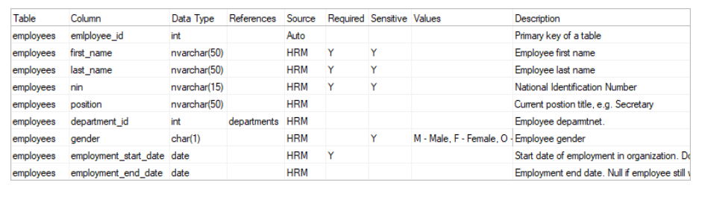
Data dictionary

Slide 21
Database instance
The collection of information stored in the database at a particular moment is called an instance of the database.

Slide 22
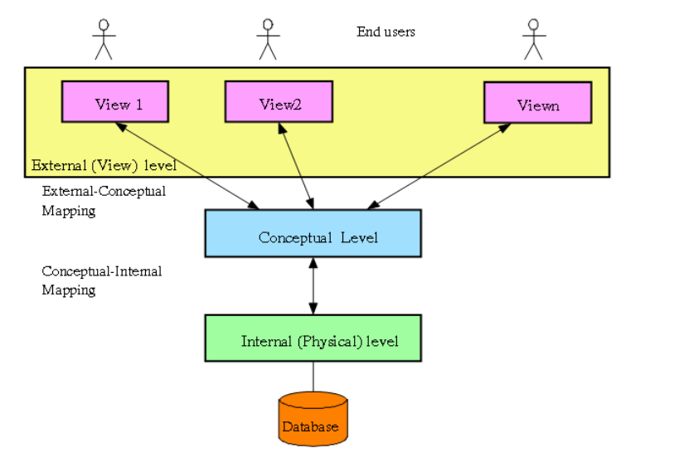
Three tier architecture
Notes:
External level:
In this highest level, there exists a number of views which of is defined a part of the actual database.
Each view is provided for a user or a group of users so that it helps in simplified the interaction between the user and system.
Conceptual level: Conceptual Schema in this level describes the logical structure of the whole database.
The entire database is described using simple logical concepts such as objects, their properties or relationships. Thus the complexity of the implementation detail of the data with be hided from the users.
Internal level: Internal Schema in this level describes how the data are actually stored, how to access the data.

Slide 23
Types of database systems
Classification can be done based on
data models (relational, hierarchical, network, object oriented)
Number of users (single user/ personal, multi-user/organizational)
Ways database is distributed (centralized, distributed, homogenous distributed, heterogenous distributed)

Slide 24
Relational model
The relational model uses a collection of tables to represent both data and the relationships among those data.
Each table has multiple columns, and each column has a unique name.
The data is arranged in a relation which is visually represented in a two dimensional table.
a tuple is represented by a row,
an attribute is represented by a column of the table,
attribute name is the name of the column
attribute value contains the value for column in the row.
Values in a column are of a specific type, i.e. all values have data types

Slide 25
Relational model
A relation schema R,
denoted by R(A₁, A², ..., A_{n}),
is made up of a relation name R
and a list of attributes, A₁, A₂, ..., A_{n}.
Each attribute A_{i} is the name of a role played by some domain D in the relation schema R
Notes:
A relation of degree seven, which stores information about university students, would contain seven attributes describing each student. as follows:
STUDENT(Name, Ssn, Home_phone, Address, Office_phone, Age, Gpa)

Slide 26
Relational Model
A key is that data item that exclusively identifies a record.
The value of a key attribute can be used to identify uniquely each tuple in the relation.
Types of keys
  Candidate key - a super key that is minimal; that is, there is no proper subset that is itself a superkey.
  Super Key- a set of one or more attributes whose combined value uniquely identifies the entity in the entity set.
  Primary Key- an attribute that uniquely identifies an entity
  Composite Key- more than one column as part of the primary key. These are called composite keys or concatenated keys.
  Foreign Key - the foreign key of a relation may be the primary key of another relation.
  Secondary Key- A Secondary Key is an attribute or combination of attributes that may not be a candidate key but classifies the entity set on a particular characteristic.

Slide 27
Relational Model
Relationship - an association between two or more entities
One to One (1:1) Entity Relationships
One entity is related to only one other entity of a particular type
Not a common type of relationship
One to Many (1:M) Entity Relationship
Most common type of relationship
One entity can be related to more than one other entity
A supplier can supply more than one product to a company

Slide 28
Relationships
3. Many to Many (M:M) Entity Relationships
One entity can be related to more than one other entity, and those entities can be related to multiple entities of the same type as the original entity
4. Many to One (M: 1)

Slide 29
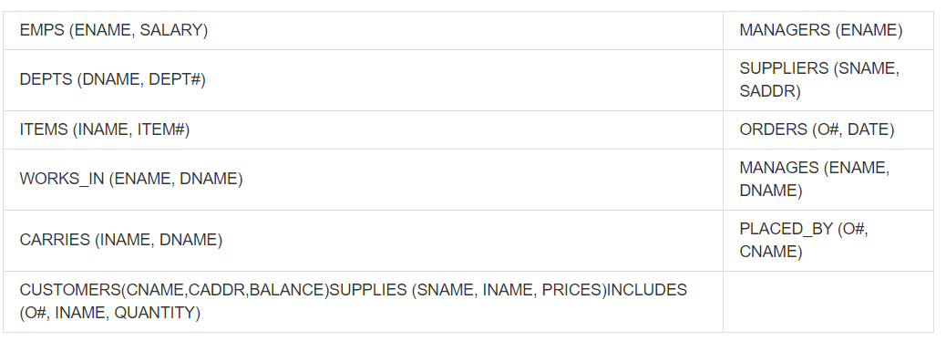
Relational model

Slide 30
A Sample Relation
EmployeeNumber | FirstName | LastName
100 | Mary | Abernathy
101 | Jerry | Cadley
104 | Alex | Copley
107 | Megan | Jackson

Slide 31
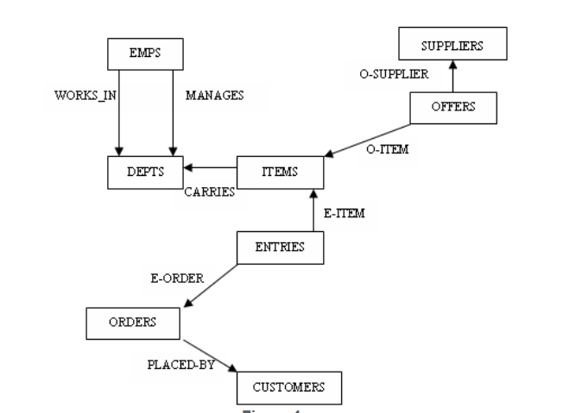
Network Model
The Network model represents data as record types and also represents a limited type of one to many relationship, called set type

Slide 32
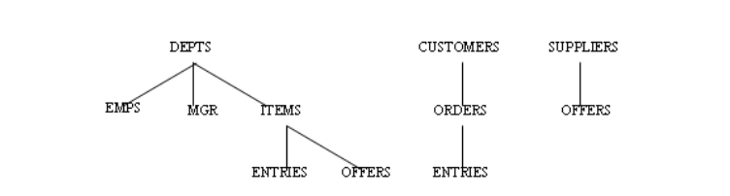
Hierachical Model
The Hierarchical model represent data as hierarchical tree structures.
Each hierarchy represents a number of related records.

Slide 33
Object oriented model
Information is represented in the form of objects as used in object-oriented programming

Slide 34
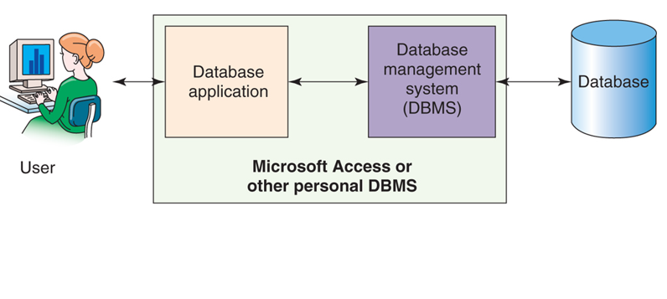
Personal databases
Also called single user databases
Personal database systems typically
  have one application.
  have only a few tables.
  are simple in design.
  involve only one computer.
  support one user at a time.

Slide 35
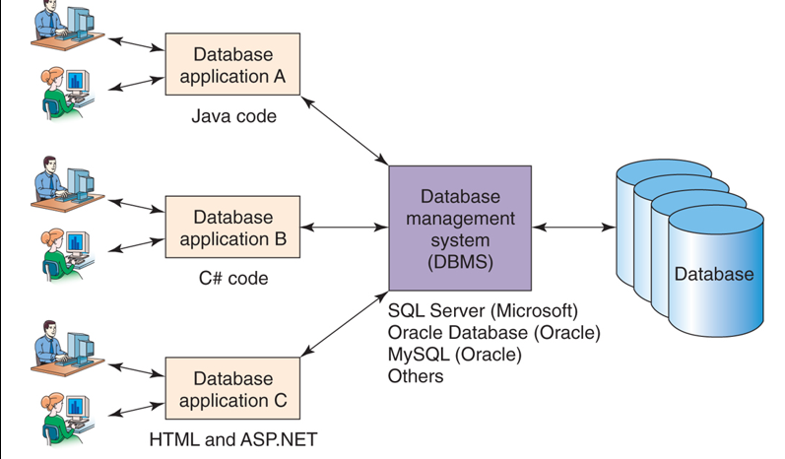
Organisational databases
Also called multi-user databases
Enterprise-Class database systems typically:
  support several users simultaneously,
  include more than one application,
  involve multiple computers,
  are complex in design,
  have many tables, and
  have many databases.

Slide 36
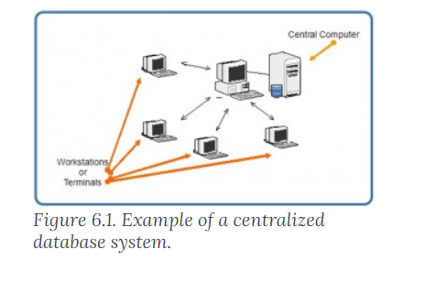
Centralised databases
The DBMS and database are stored at a single site that is used by several other systems too

Slide 37
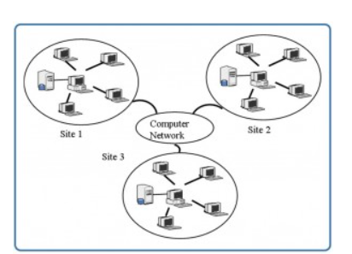
Distributed databases
The actual database and the DBMS software are distributed from various sites that are connected by a computer network
use the same DBMS software at multiple sites (homogenous)
different sites might use different DBMS software, but there is additional common software to support data exchange between these sites( heterogenous)

Slide 38

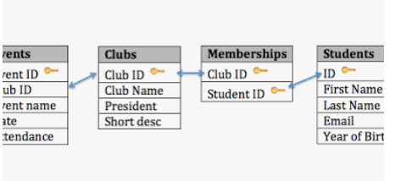
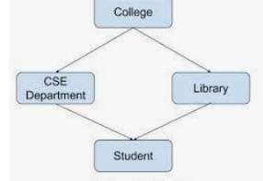
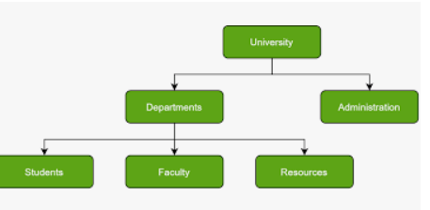
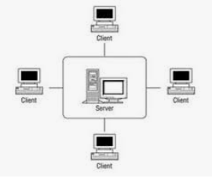
Summary
Identify which type of database is represented in the diagrams

Slide 39
Take home
State advantages and disadvantages of each type of database
Describe each type of database paying attention to
How data is stored
How it is accessed
Application areas
Draw a table of common data types giving example values for each data type.

Slide 40
Next Lesson
Attend the practical/ lab sessions
The database development process

Slide 41
References
Deborah Morley and Charles S. Parker (2015). Understanding Computers Today and Tomorrow. Cengage Learning
Kroenke, D. M. & Auer, D. (2018). Database concepts (9th ed.), Pearson

